Slide 1

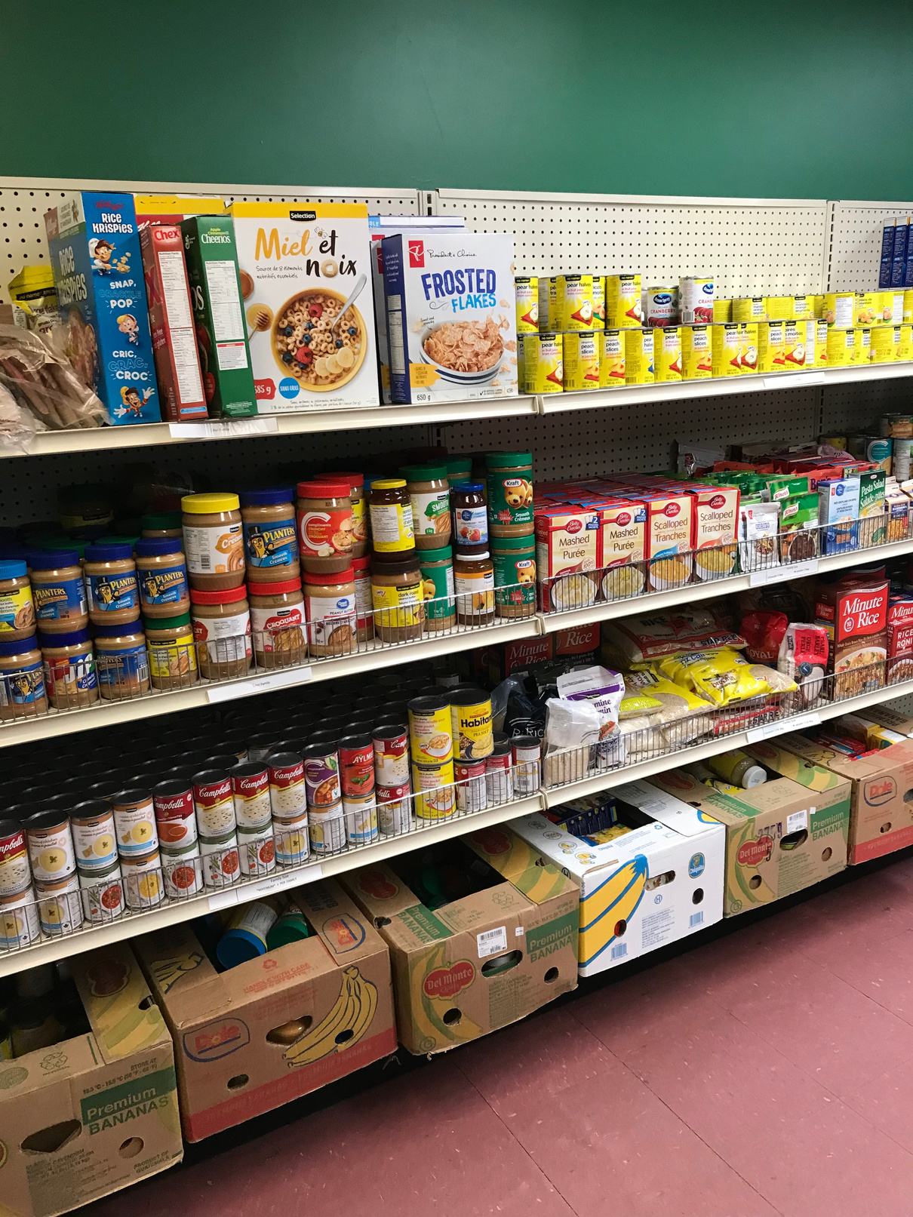


DID YOU KNOW?
24,268
We distributed
emergency hampers in 2025.
5%
That’s a increase over the same period in 2024 and a increase since this
same time in 2023.
29%
**Period ending December 2025

Slide 2
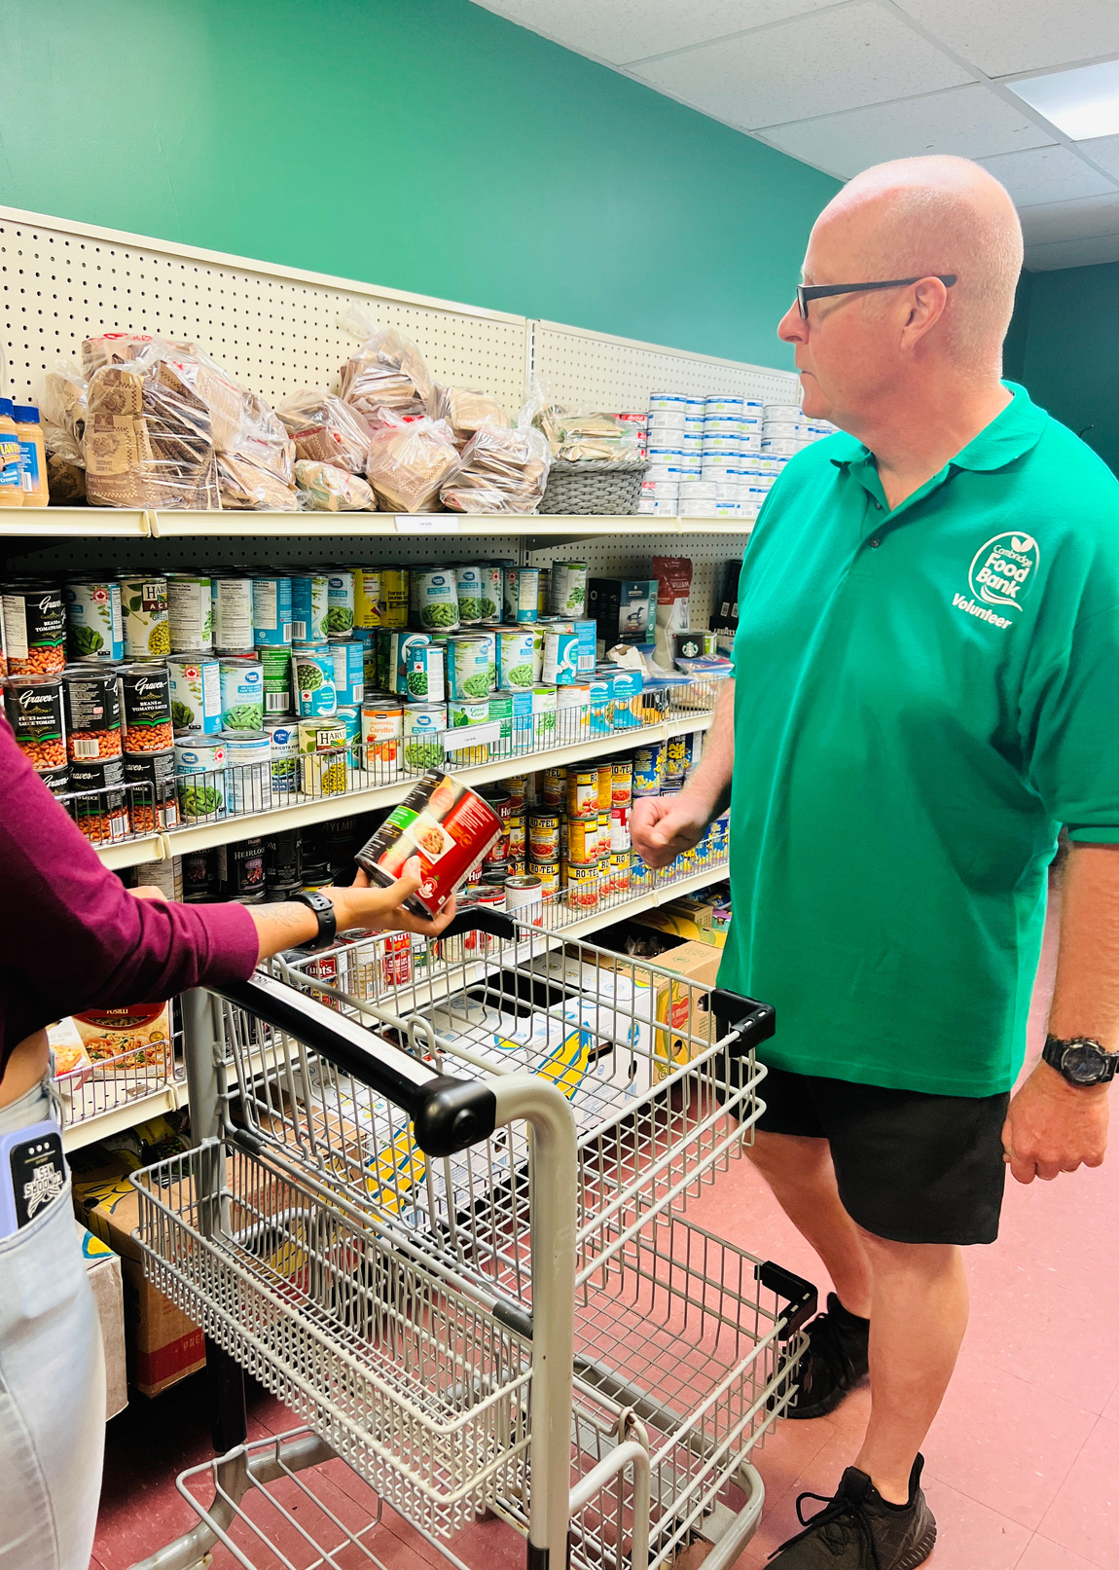
The Cambridge Food Bank is routed in
delicious dignity.

Slide 3
This means we offer a grocery model and participants get to
choose
culturally
appropriate food. We do not pre pack emergency hampers.

Slide 4

How Can You Help?
With a Food & Fund Drive

Slide 5
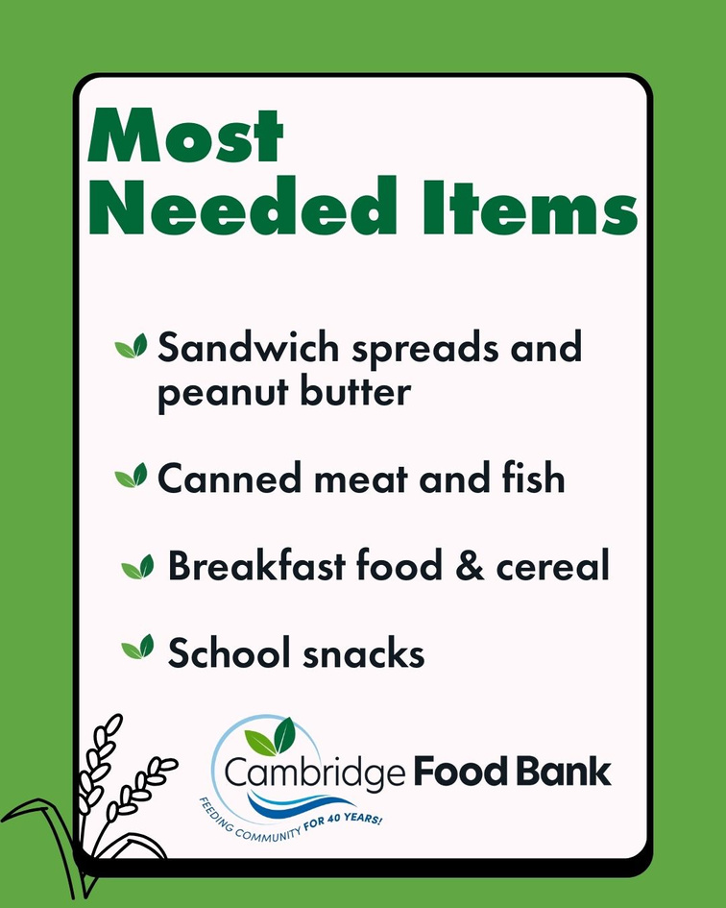

Most Needed Food Items

Slide 6
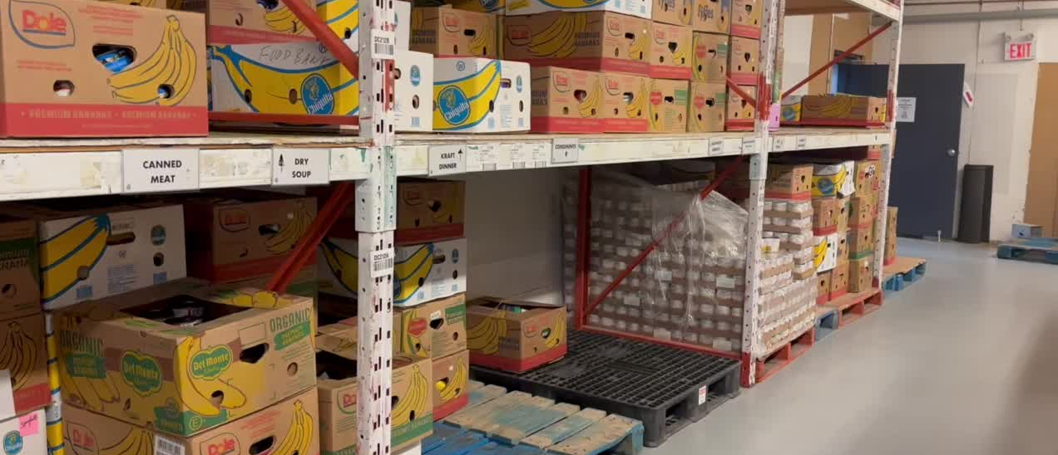
Your support in collecting non-perishable foods helps us keep our shelves full.

Slide 7
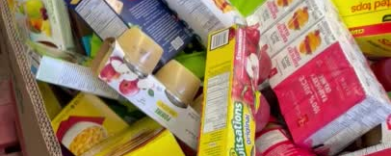
So we can continue responding to the increasing need for food assistance.

Slide 8
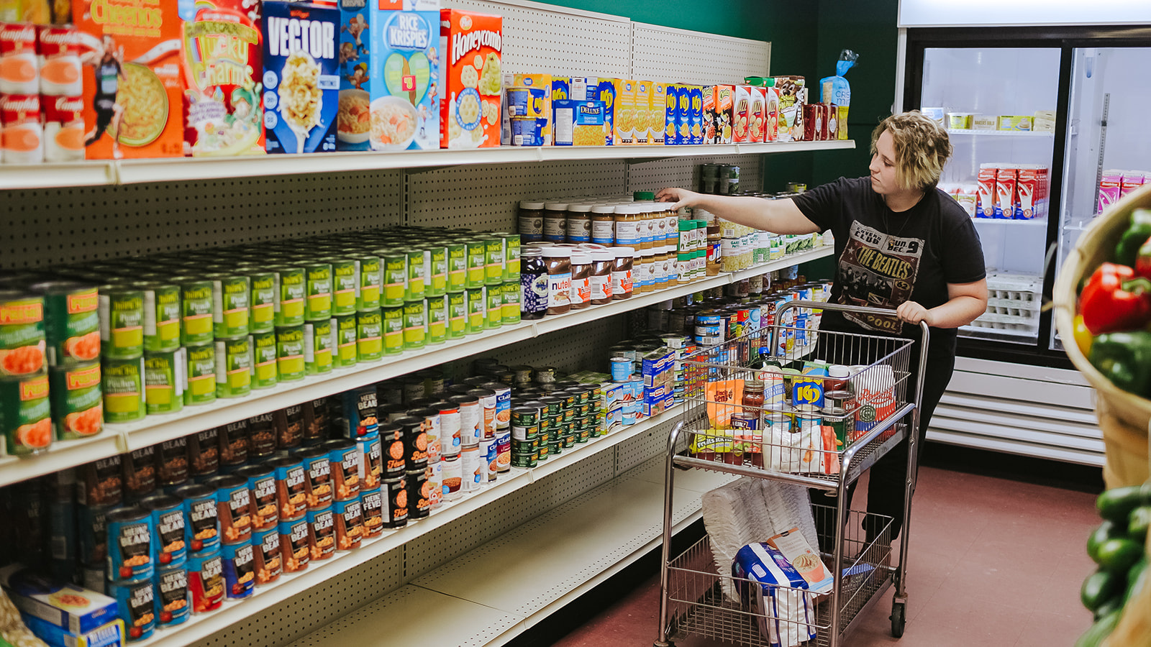
None of us is immune to need – you may not think you need a food bank
until one day, you do.

Slide 9
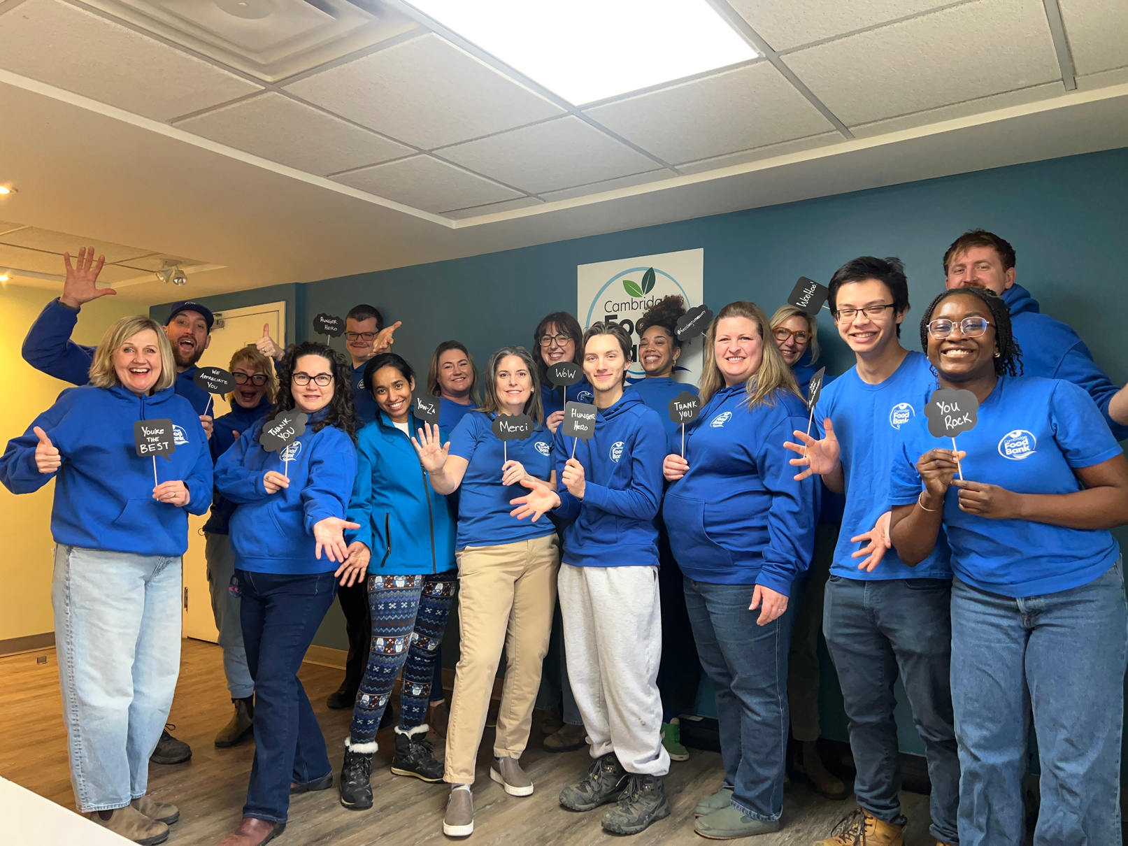
THANK YOU
for your support.

